Slide 1
Chapter 1
INTRODUCTION TO ENGINEERING DRAWING
The role of engineers is to design & develop the products. In their business, engineers have to prepare drawings to convey their ideas. The graphical language used by engineers is called as Engineering Drawing. Just as a picture speaks thousands of words, a complete technical drawing tells everything about the geometry of the product.
To draw accurate drawings, various instruments & accessories are used. These are explained on next slide.

Slide 2
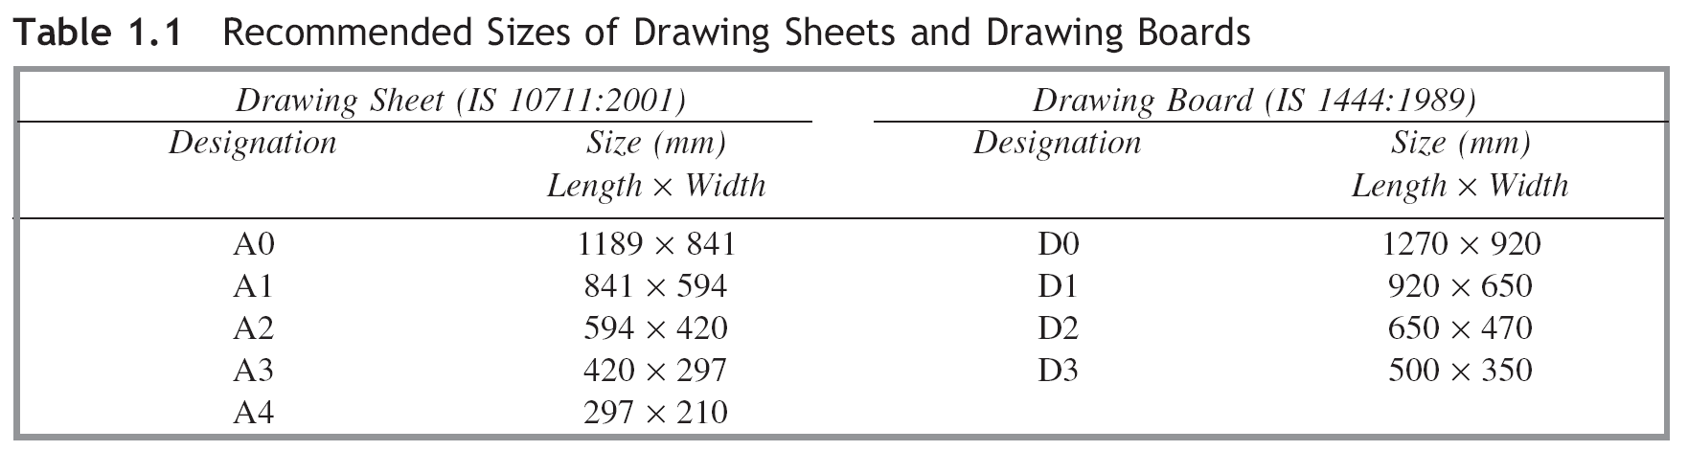
1.3 DRAWING INSTRUMENTS AND ACCESSORIES
1.3.1 Drawing Sheets and Papers
Drawing sheets and papers are the ‘canvases’ on which drawings are composed by pencils or pens. Drawing sheets are available in standard sizes. Indian Standards (IS) for drawing sheets and drawing boards as recommended by the Bureau of Indian Standards (BIS) are shown in Table 1.1.

Slide 3
Grid Sheet
File for Grid Sheet
0.7 mm Lead pencil – Clutch Pencil
Eraser
15 cm Scale (Plastic)
15 cm Roller Scale
Protractor
Compass

Slide 4
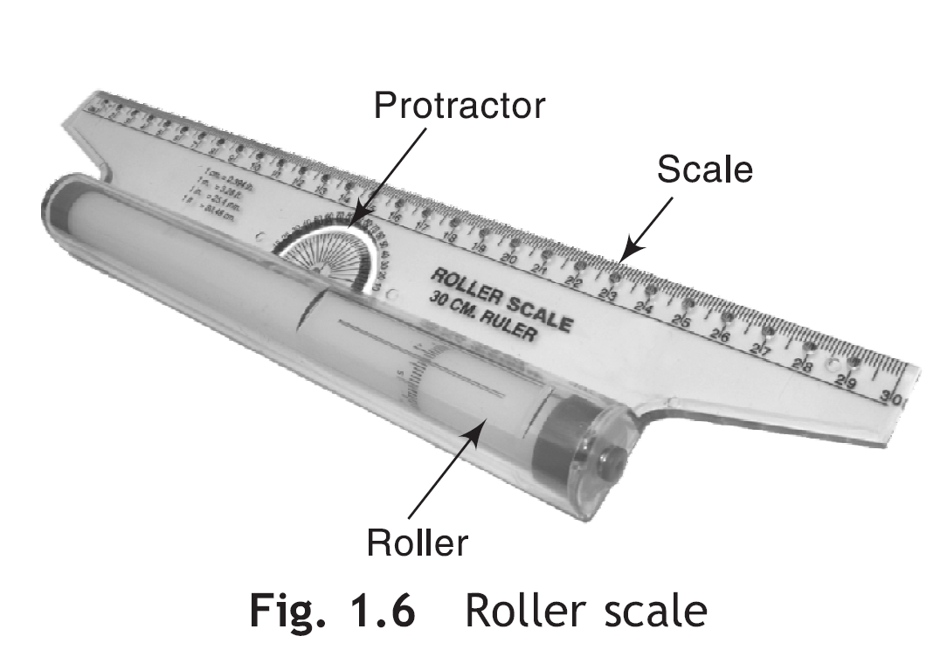
Roller Scale
A roller scale is a handy device used to draw parallel and inclined lines. It is a speedy device and may be used for practice in classrooms.
Protractor
Protractor is used to draw and measure the angles. It is available separately or as merged in 45° set-square.

Slide 5
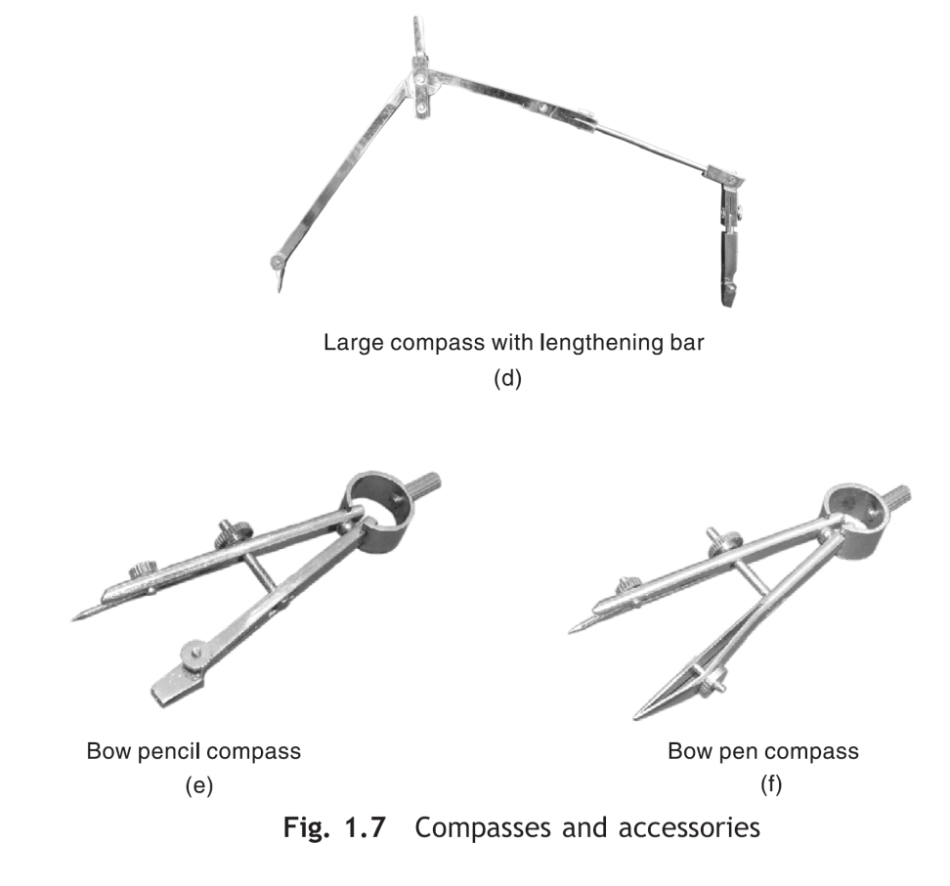
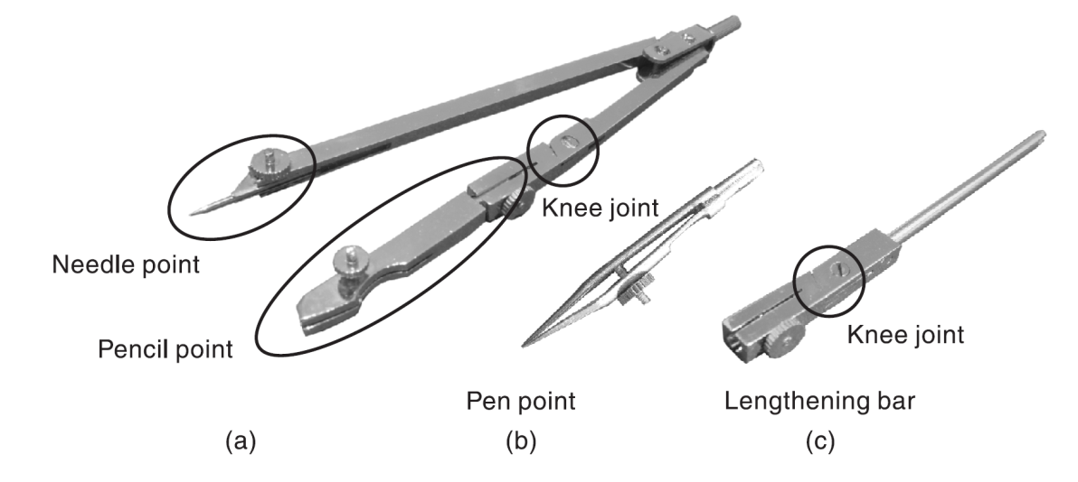
Compasses
Compasses are used to draw circles or arcs. Two sizes of compasses—(i) large compass and (ii) small spring bow compass are in common use. A large compass consists of a needle leg and a pencil leg hinged together at upper ends, Fig. 1.7(a). The two legs carry, respectively, a needle point and a pencil point at their lower ends. The pencil point can be interchanged with a pen point, Fig. 1.7(b). Lengthening bar, Fig. 1.7(c), is used to draw circles of diameter greater than 150 mm. Small spring bow compasses are of two types: bow pencil compass, Fig. 1.7(e) and Bow pen compass, Fig. 1.7(f).

Slide 6
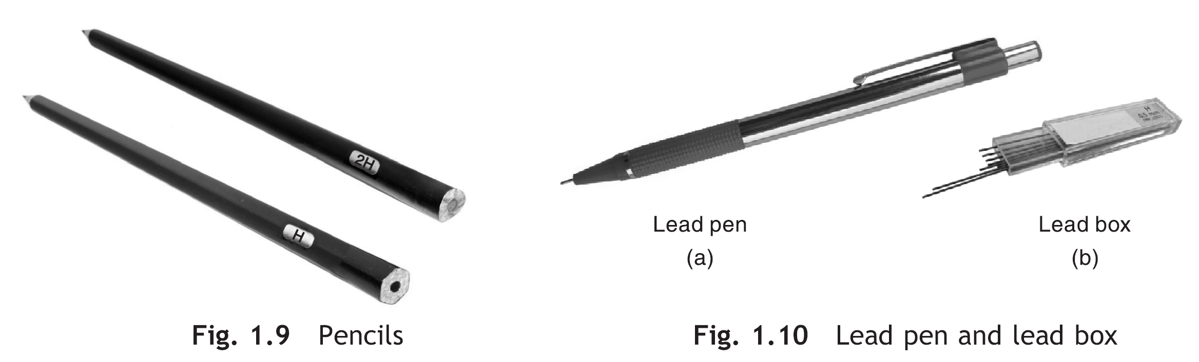
Pencils/Lead Pens
The quality of drawing largely depends on the selection and use of proper grade of pencil. The grade of a pencil is printed near its blocked end. For technical drawing, three grades of pencils, namely, H, 2H and HB are recommended. A lead pen, Fig. 1.10, is an alternative to the pencil.

Slide 7
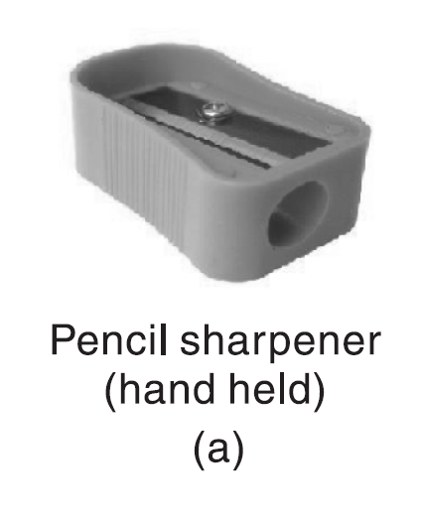
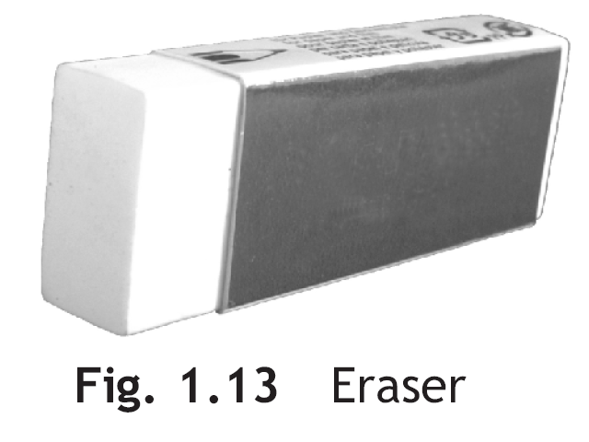
Pencil Sharpener
A pencil sharpener is a device used to mend the pencils. It conveniently removes the wooden shell covering the lead. A common hand-held sharpener, Fig. 1.12(a), is recommended.
Eraser
A non-dusting good quality eraser is recommended for erasing unwanted part of the pencil drawing.

Slide 8
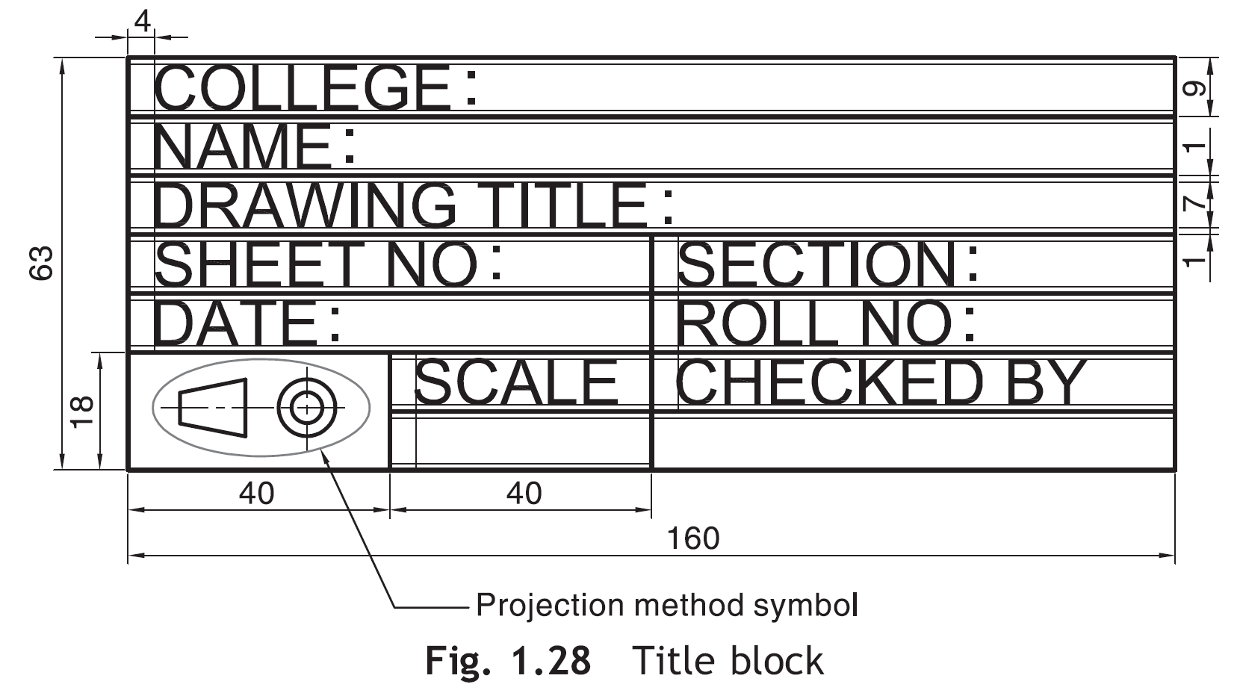
The title block is located at the bottom right corner of the frame attached to the frame lines, Fig. 1.27. It typically includes information like, name of the organization, name of the designer or draftsman, drawing title, scale of the drawing, etc. The projection method symbol is also included in the title block.

Slide 9
TIPS FOR GOOD QUALITY DRAWING
Sharpen the tip of the pencil from time to time.
Use a proper grade of the pencil and/or lead, i.e., H, 2H or HB as the case may be.
Avoid frequent use of eraser.
Complete a line, circle or arc in one stroke only. Avoid overdrawing.
Maintain constant hand pressure while drawing a particular line, circle or arc.

